Slide 1
Database

Slide 2
Topics
What is Database (DB)
Relational VS Non-relational DB
Tables
Relational Database Management System (RDBMS)
Most Popular DB
Basic SQL commands

Slide 3
Chapter Objectives
By Completing this chapter, you should be able to:
Understand the concept of Database (DB)
Differentiate between Relational and Non-relational DB
Understand Tables in DB
Understand the Relational Database Management System(RDBMS)
To know the most common RDBMS
Get familiar with basic SQL commands

Slide 4
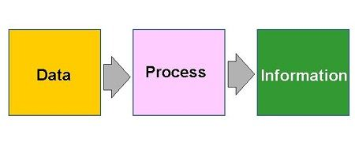
What is Data and Information
Data is raw, unorganized facts that need to be processed. Data can be something simple and seemingly random and useless until it is organized.
Information is data that has been processed, organized or presented in such a way as to be meaningful and useful to the person who receives it
Example: The history of temperature readings all over the world for the past 100 years is data. If this data is organized and analyzed to find that global temperature is rising, then that is information.

Slide 5
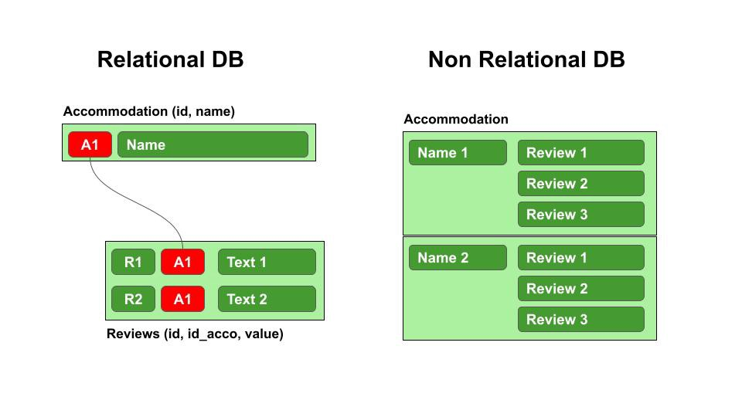
What is a Database (DB)
Database is a set of data stored in a computer. This data is usually structured in a way that makes the data easily accessible.
A Relational Database is a type of database uses a structure that allows us to identify and access data in relation to another piece of data in the database. Often, organized into tables
A non-relational Database is a type of database that does not store data in tables. Instead, this type of database uses a hierarchical structure to store data in collections.

Slide 6
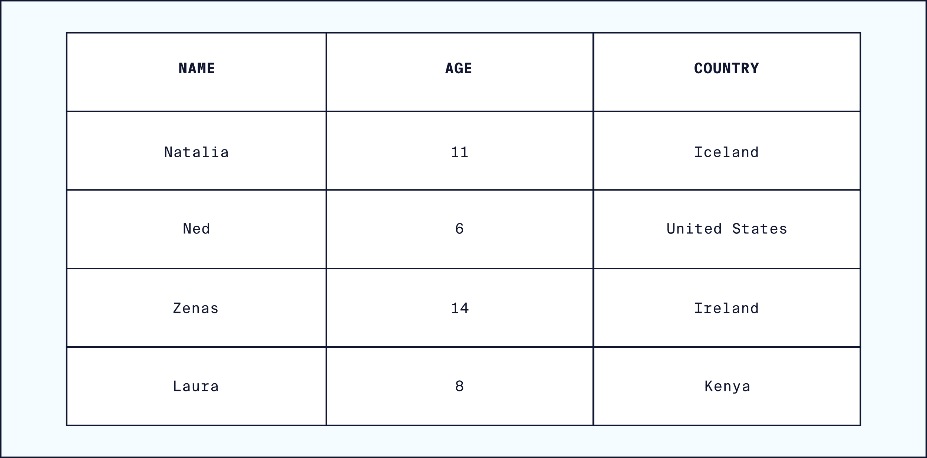
Tables: Rows and Columns
Tables can have hundreds, thousands, sometimes even millions of rows of data.
Rows are often called records.
Tables can also have many columns of data.
Columns are labelled with a descriptive name (say, age for example) and have a specific data type.

Slide 7
Relational Database Management System(RDBMS)
RDBMS is a program that allows you to create, update, and administer a relational database.
Most RDBMS use the SQL language to access the database.
SQL (Structured Query Language) is a programming language used to communicate with data stored in a relational database management system.
SQL syntax is similar to the English language, which makes it relatively easy to write, read, and interpret.
Popular RDBMS : MySQL, PostgreSQL, SQL Server, SQLite, Oracle DB.

Slide 8
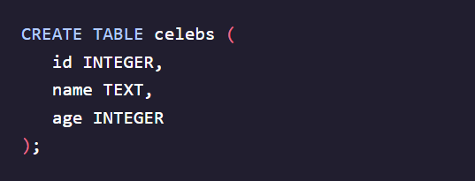
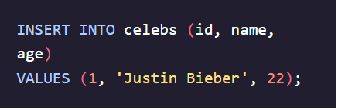
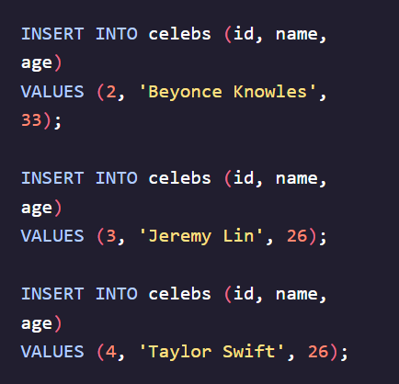
SQL DB Manipulation : CREATE, INSERT
CREATE statements allow us to create a new table in the database.
INSERT statement inserts a new row into a table.

Slide 9

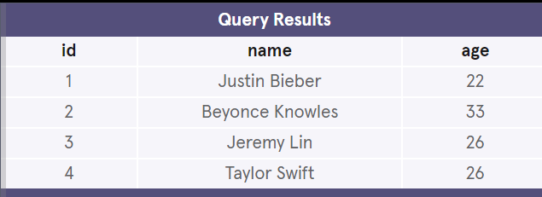
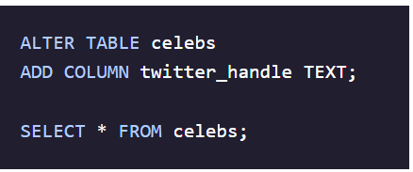
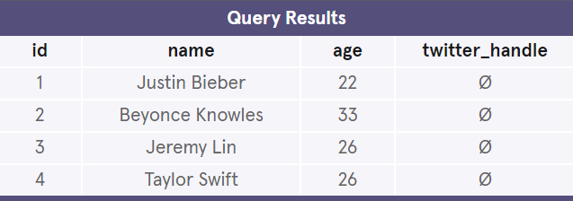
SQL DB Manipulation : SELECT, ALTER TABLE
SELECT statements are used to fetch data from a database.
ALTER TABLE statement is used to modify the columns of an existing table. When combined with the ADD COLUMN clause, it is used to add a new column

Slide 10
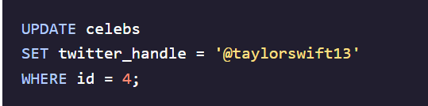
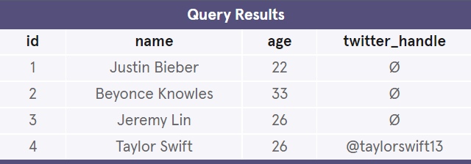
SQL DB Manipulation : UPDATE
UPDATE statement is used to edit records (rows) in a table. It includes a SET clause that indicates the column to edit and a WHERE clause for specifying the record(s).

Slide 11
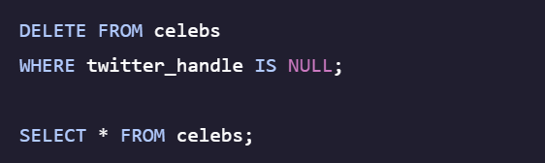
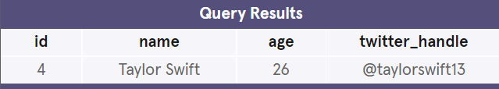
SQL DB Manipulation : DELETE
DELETE statement is used to delete records (rows) in a table. The WHERE clause specifies which record or records that should be deleted. If the WHERE clause is omitted, all records will be deleted.

Slide 12
Wrapping up
In this chapter we discuss the concepts:
Database (DB).
Relational and Non-relational DBs
Relational Database Management System(RDBMS)
We explained the basic commands in SQL

